Slide 1
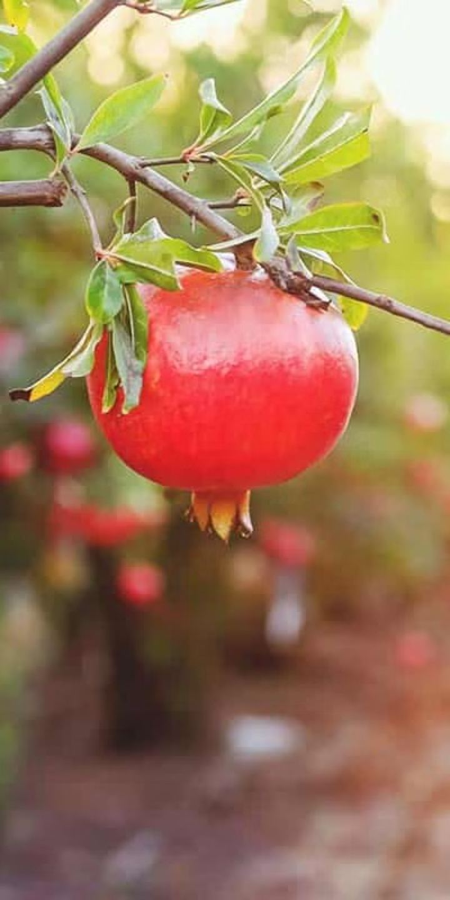

Pomegranate Fruit Disease Detection
Authors :
1) Anant Chikmurge-20221CAI0079
2) Varshith Narayana - 20221CAI0094
3)Mayur R -20221CAI0090
4) Lokesh T-20221CAI0081
5) Vikrant Reddy-20221CAI0063
6)Pakruddin B

Slide 2
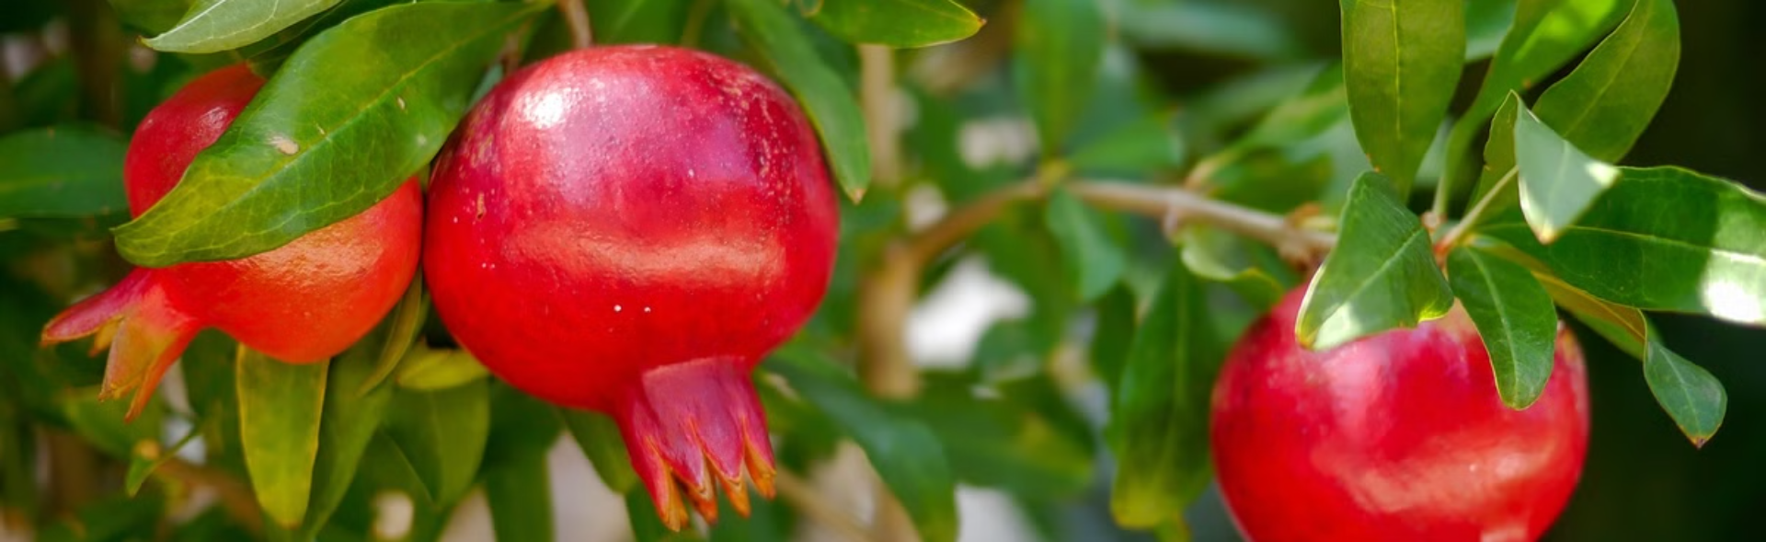
Introduction
1
Disease Challenges
Pomegranate crops face various diseases that impact yield and uality
2
Early Detection
Rapid identification is key to implementing effective treatment
3
Impact on Agriculture
Minimizing crop loss ensures better productivity and profitability for farmers

Slide 3
Proposed Methodology
KNN
CNN
SVM
Simple non-parametric method for classifying diseases
Powerful deep learning model for image recognition
Robust linear classifier to distinguish disease types
classifies data by finding the majority class among the K-nearest neighbors based on feature distance.
automatically learns features but requires large datasets and significant computational resources.
uses pre-extracted features to find an optimal hyperplane for classifying data with maximum margin.

Slide 4
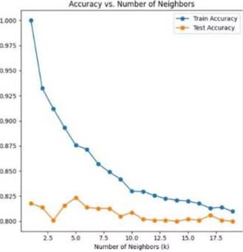
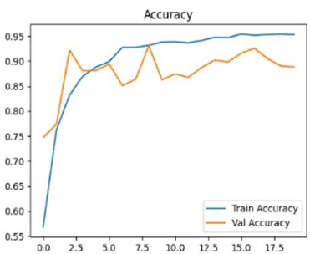
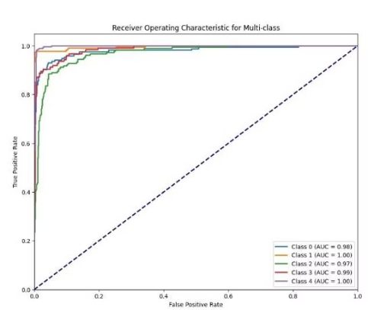
Results
KNN Accuracy
CNN Accuracy
SVM Accuracy
82% accuracy in disease classification
98% accuracy in disease classification
93% accuracy in disease classification

Slide 5
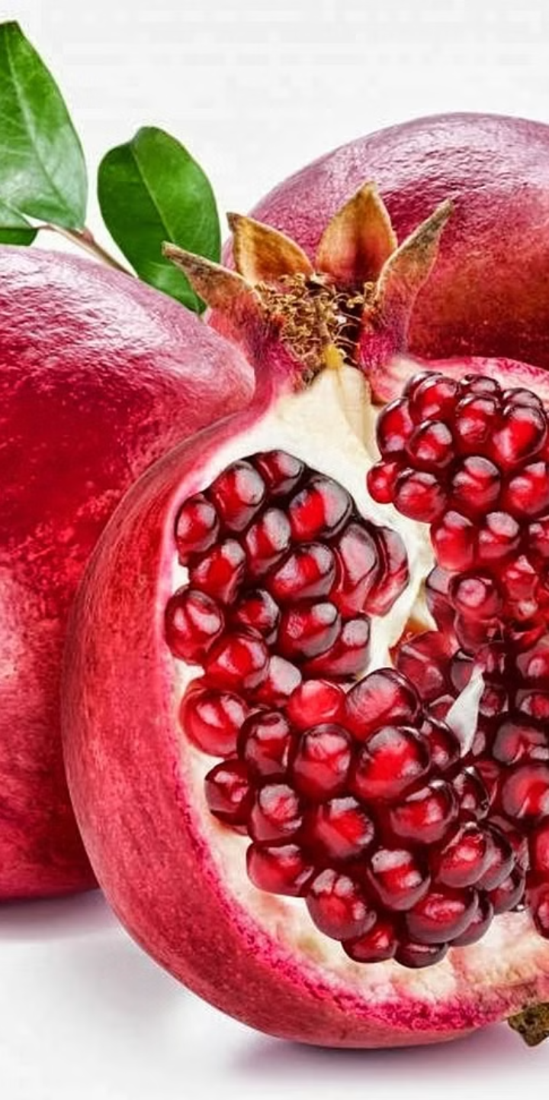
Conclusion
1
Effective Models
CNN proved most accurate for pomegranate disease detection
2
Real-World Impact
Empowers farmers to quickly identify and treat diseases
3
Future Work
Expand dataset, explore ensemble methods for even higher accuracy

Slide 6
References
[1] Pakruddin, B., Hemavathy, R. (2024). A Systematic Review of Pomegranate Fruit Disease Detection and Classification Using Machine Learning . https://doi.org/10.1007/978-981-99-9486 1_13
[2] Jadhav, S.B., Udupi, V.R. & Patil, S.B. Identification of plant diseases using convolutional neu-ral networks. Int. j. inf. tecnol. 13, 2461–2470 (2021). https://doi.org/10.1007/s41870-020-00437-5.
[3]Manisha Bhange, Pomegranate Disease Detection Using ImageProcessing,Procedia Computer Science,Volume 58,2015,Pages 280-288,ISSN 1877-0509, https://doi.org/10.1016/j.procs.2015.08.022.

Slide 7
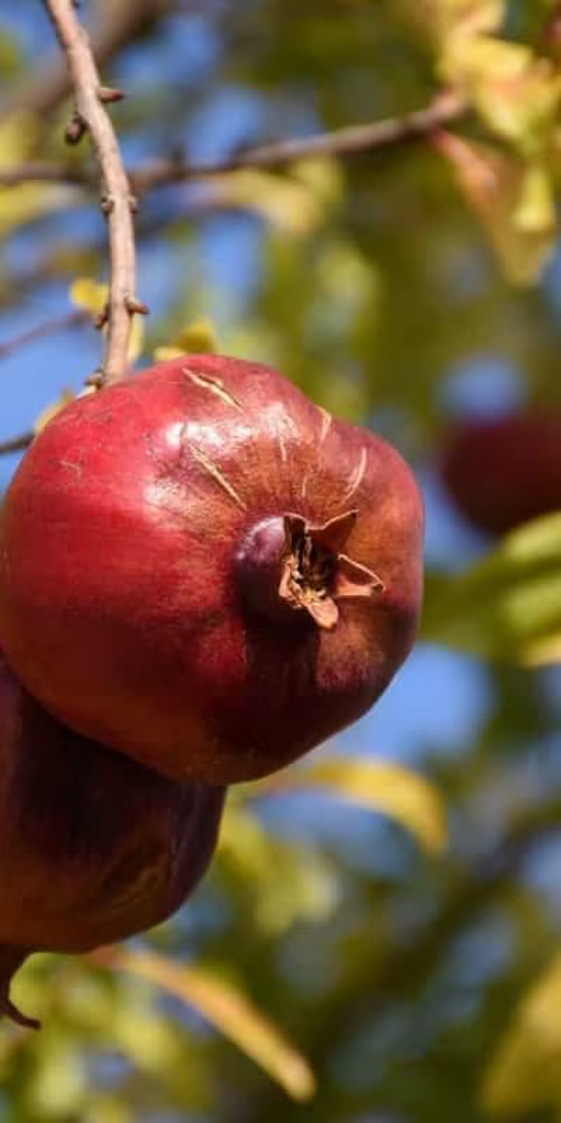




Sample Prediction
Healthy
No visible signs of disease
Anthracnose
Dark sunken lesions on fruit
Bacterial Blight
Browning and cracking of fruit
Cercospora
small, dark leaf spots with a yellow halo
Alternaria
dark, concentric ring spots on Fruits

Slide 8


Slide 9


